Slide 1
Requirement Prioritization
Imran Mahmud

Slide 2
Definition
In order to develop cost effective quality software, it is really necessary to select the right requirements from the set of all requirements. It would be more beneficial if they are grouped release wise. In this way, we can decide upon which requirements need to be focused in any particular release

Slide 3
Benefits
Constraint Driven strategy
Time and budget constraints do not allow entertaining all requirements. Therefore, project manager can use prioritization as a tool to help him in selection of those requirements that can be implanted in a certain time and budget constraints.

Slide 4
Planning the Releases
Prioritization helps the stakeholders decide the type of requirements of the system and categorize them in optimal requirements sets. Based on these optimal sets a project manager can plan the releases of the product. In its normal flow; system’s core requirements will be implemented in first release and based on their priority values the next group of requirements will be implemented in successive releases.

Slide 5
Balancing benefits against cost
Before starting implementation, key stakeholders should identify related requirements and their corresponding benefits. Similarly, each of these requirements shall be evaluated for implementation cost. Prioritization based on the benefit and related cost; may help the business to balance their benefits of each requirement against the cost of implementing it.

Slide 6
Negotiating conflicts:
Conflicts between stakeholders arise because their viewpoints for most of the requirements are different. Requirements prioritization often involves negotiation process to handle contradictory requirements. Therefore it also helps in resolving conflicts and disagreement between stakeholders.

Slide 7
Better Understanding:
Requirements prioritization is an expensive activity to some extent, because it requires time, stakeholders’ involvement, experts’ opinions meeting, etc. On the other hand it helps all the stakeholders to understand all the requirements more closely. At the prioritization stage, each requirement is evaluated thoroughly and their implementation feasibility is checked. If certain requirements are found not-feasible then alternatives can be discovered.

Slide 8
Prioritization Parameters
Time
Cost
Penalty
Risk
Functionality

Slide 9
Prioritization Technique
AHP
B-Tree
Ranking
Top 10 requirements
100 dollar test

Slide 10
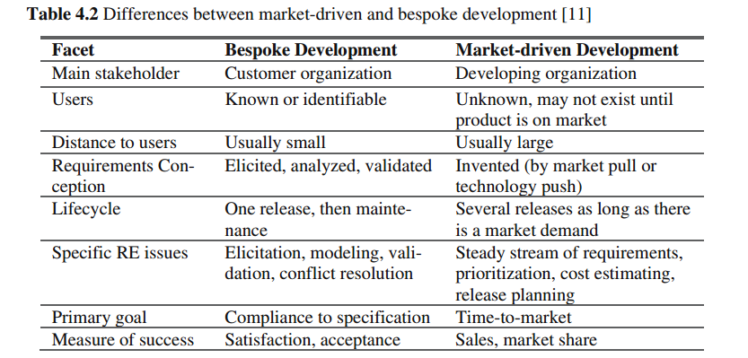
In a bespoke project, only one or a few stakeholders must be taken into consideration while everyone in the whole world might serve as potential customers in market-driven development.

